Slide 1

NYC TAXI TRIP TIME PREDICTION – Dev Rastogi

Slide 2
Challenge
To build a model that predicts the total trip duration of taxi trips in New York City.
We will be building a model which will be predicting the trip duration of taxies running in NewYork. This prediction will help customers to select the taxi based on trip duration and driver to select optimum route to their destination.

Slide 3
About Data
id - a unique identifier for each trip
vendor_id - a code indicating the provider associated with the trip record
pickup_datetime - date and time when the meter was engaged
dropoff_datetime - date and time when the meter was disengaged
passenger_count - the number of passengers in the vehicle (driver
entered value)
pickup_longitude - the longitude where the meter was engaged
pickup_latitude - the latitude where the meter was engaged
dropoff_longitude - the longitude where the meter was disengaged
dropoff_latitude - the latitude where the meter was disengaged
store_and_fwd_flag - This flag indicates whether the trip record was held in vehicle memory before sending to the vendor because the vehicle did not have a connection to the server - Y=store and forward; N=not a store and forward trip
trip_duration - duration of the trip in seconds

Slide 4
Data Pre-Processing
The dataset contains 1458644 rows and 11 columns.
Two categorical features ‘store_and_fwd_flag’ and ‘vendor_id’
Outliers present in all numerical features
Data formating steps required for datetime features
No null values present
Passenger_count, Vendor_id and trip_duration are having integer value.
pickup_datetime,dropoff_datetime is a datetime variable
pickup_longitude,pickup_latitude,dropoff_longitude,dropoff_latitude
are real numbers having float as data type *store_and_fwd_flag
and Id belongs to a string data type.

Slide 5

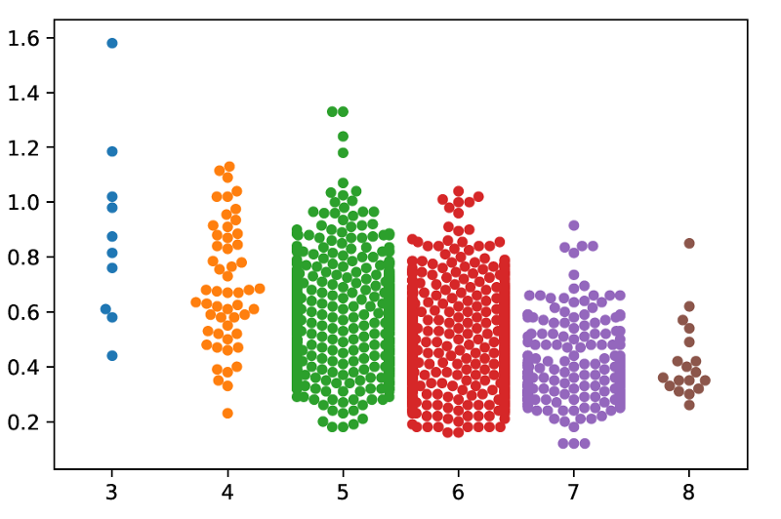
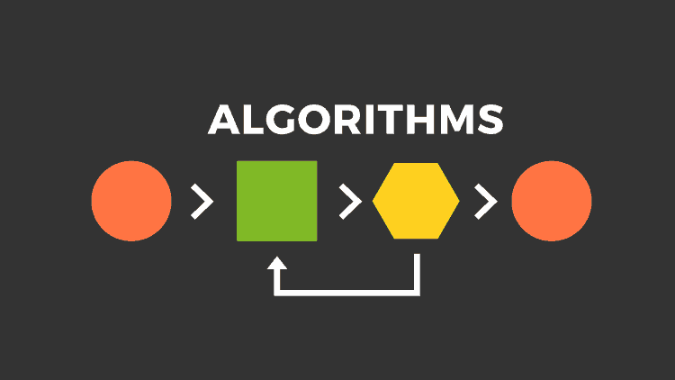
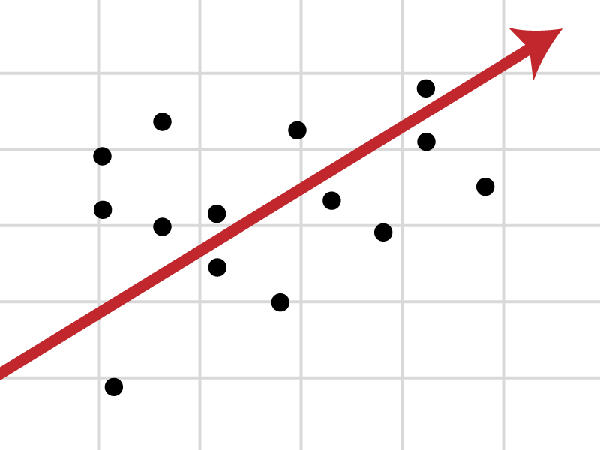
Approach
Data Preparation
and
Exploratory Data Analysis
Building Predictive Model
using Multiple
Techniques / Algorithms
Optimal Model Identified
through
Testing and Evaluation

Slide 6
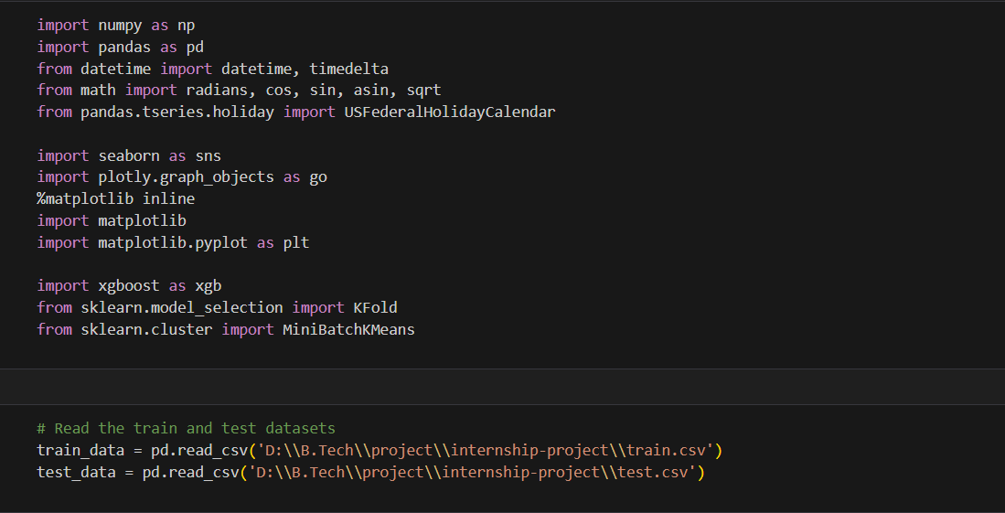
First, begin with setting our path and importing required packages

Slide 7
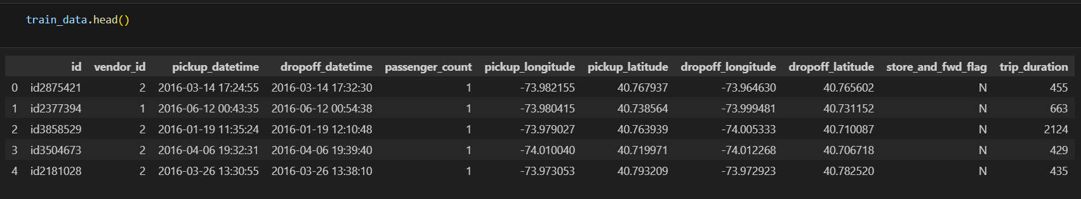
Reading the data and checking for null values

Slide 8
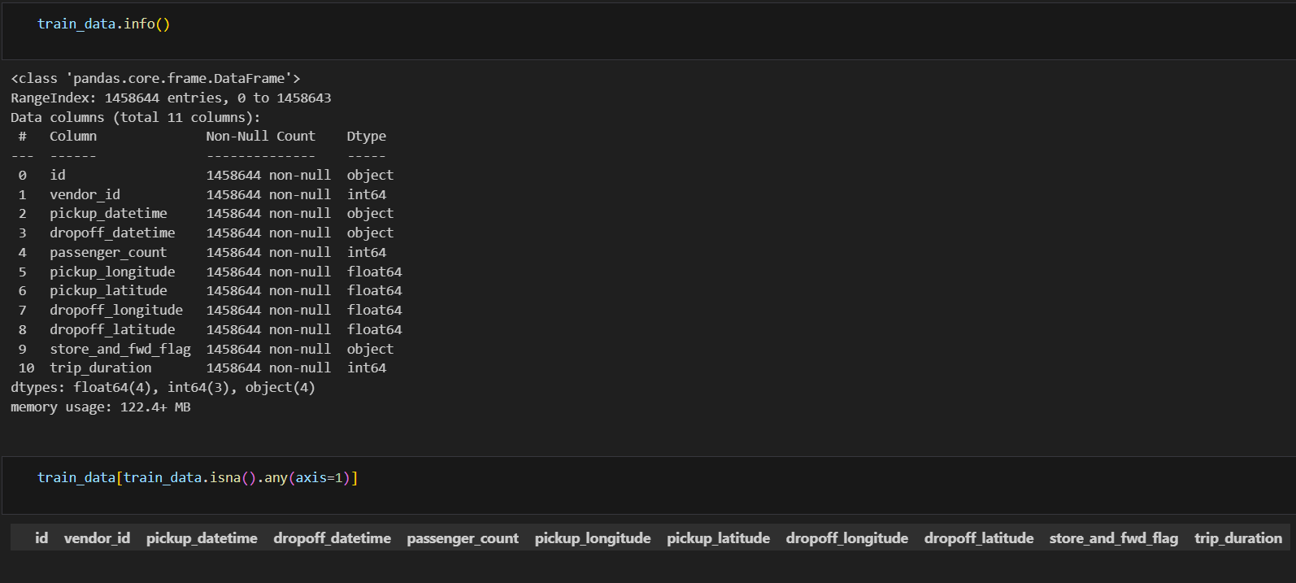

Slide 9
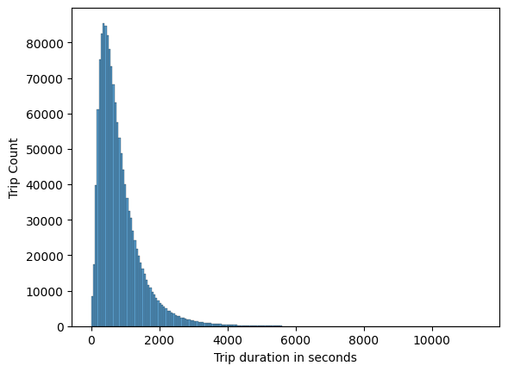
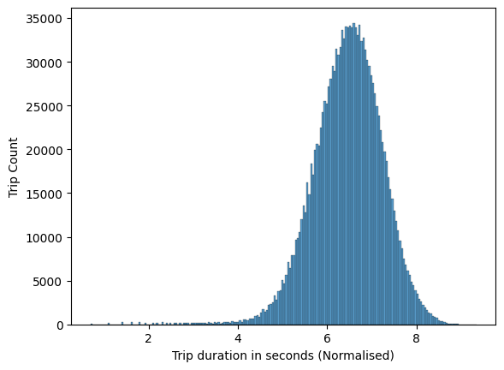
TRIP DURATION DATA ANALYSIS

Slide 10
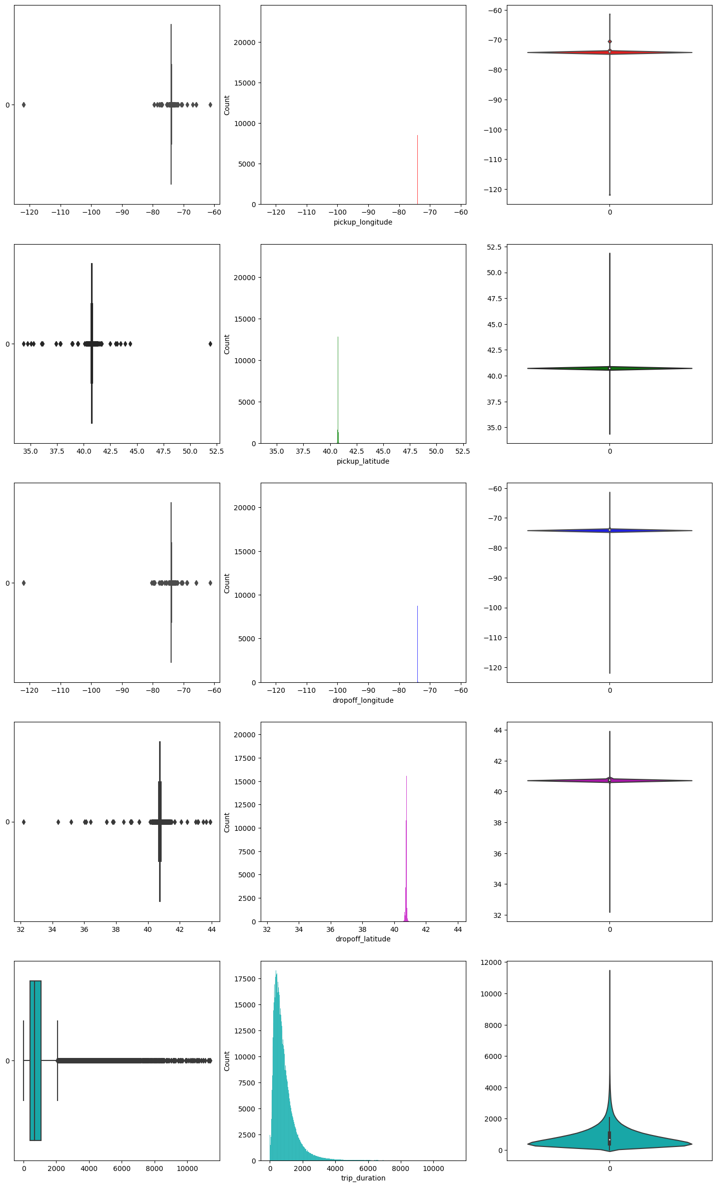

Slide 11
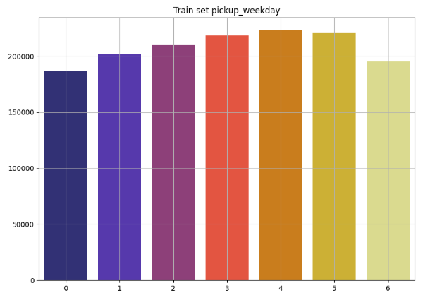
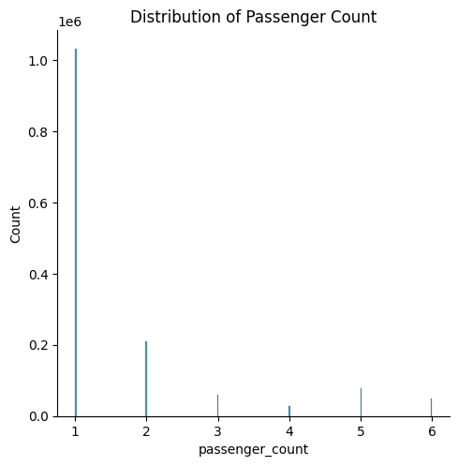
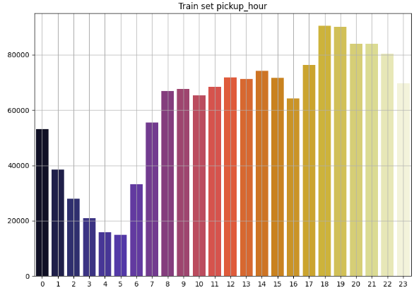

Slide 12
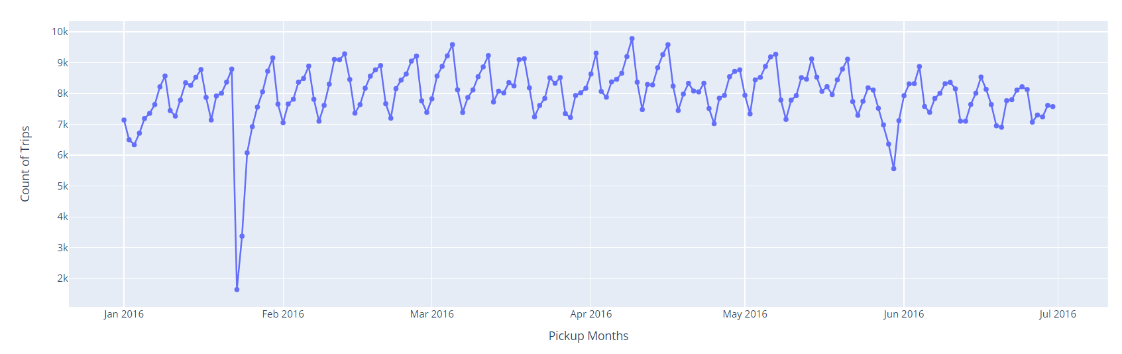
Trip counts in a particular month

Slide 13
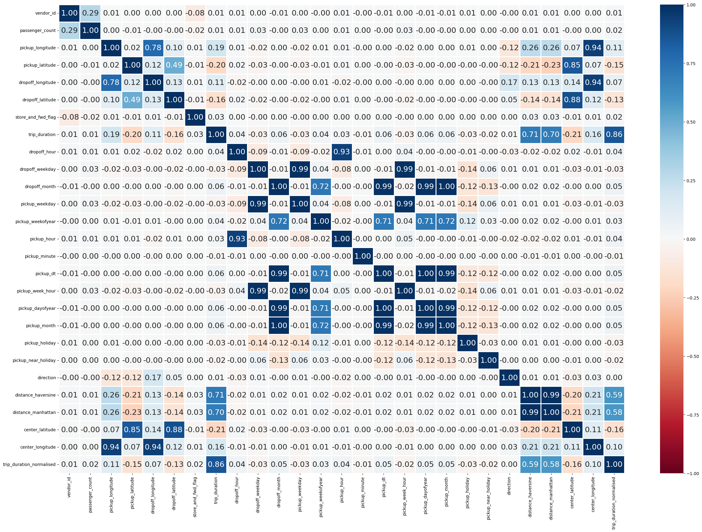

Slide 14
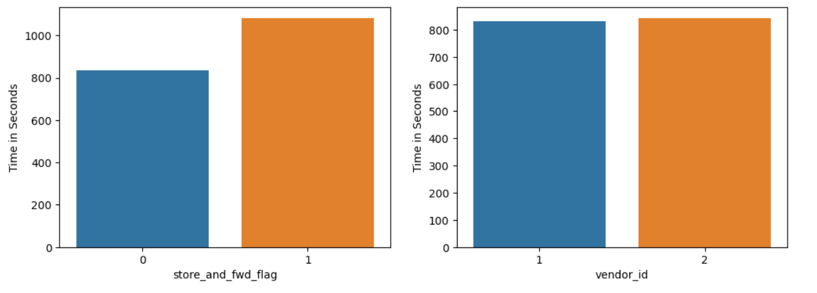
Vendor_ID stating the provider associated with trip, preferably 2 different taxi companies.
We have almost all the trip records sent to the server.

Slide 15
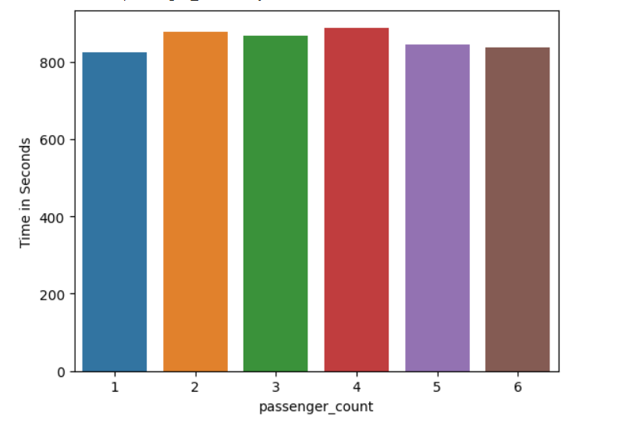
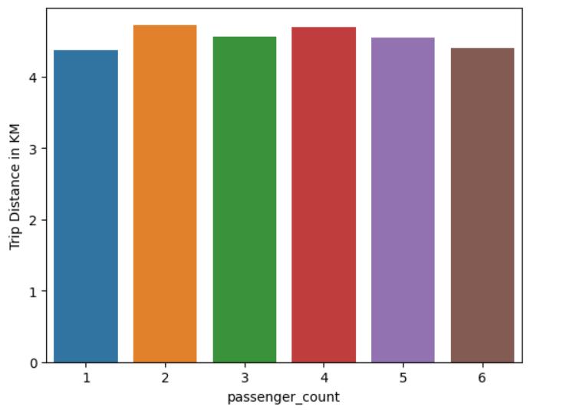
Represents the number of passenger along with the time boarded in and the distance they travelled

Slide 16
1) Data Understanding.
Building a model is one thing but understanding the data that goes into the model is another. Like a correlation matrix, feature importance allows you to understand the relationship between the features and the target variable. It also helps you understand what features are irrelevant for the model.
2) Model Improvement.
When training your model, you can use the scores calculated from feature importance to reduce the dimensionality of the model. The higher scores are usually kept and the lower scores are deleted as they are not important for the model. This not only makes the model simpler but also speeds up the model’s working, ultimately improving the performance of the model.
3) Model Interpretability.
Feature Importance is also useful for interpreting and communicating your model to other stakeholders. By calculating scores for each feature, you can determine which features attribute the most to the predictive power of your model.

Slide 17
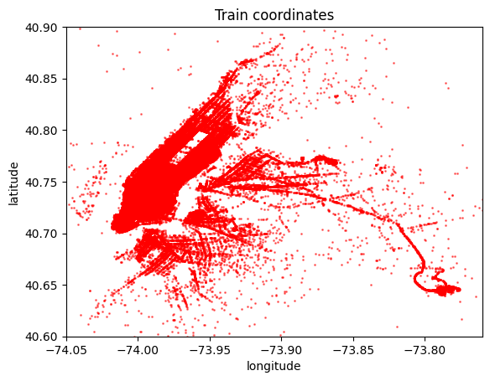
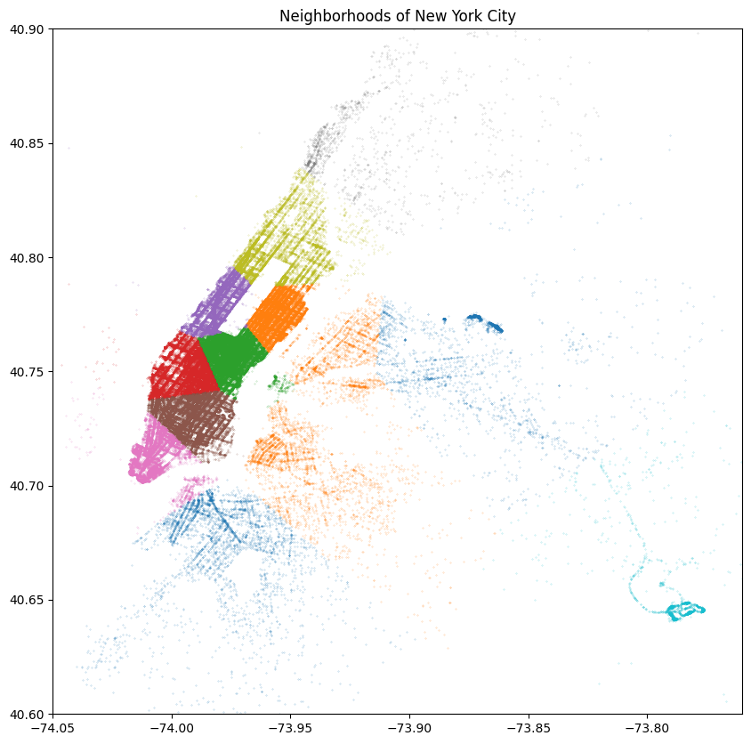
Train Model

Slide 18
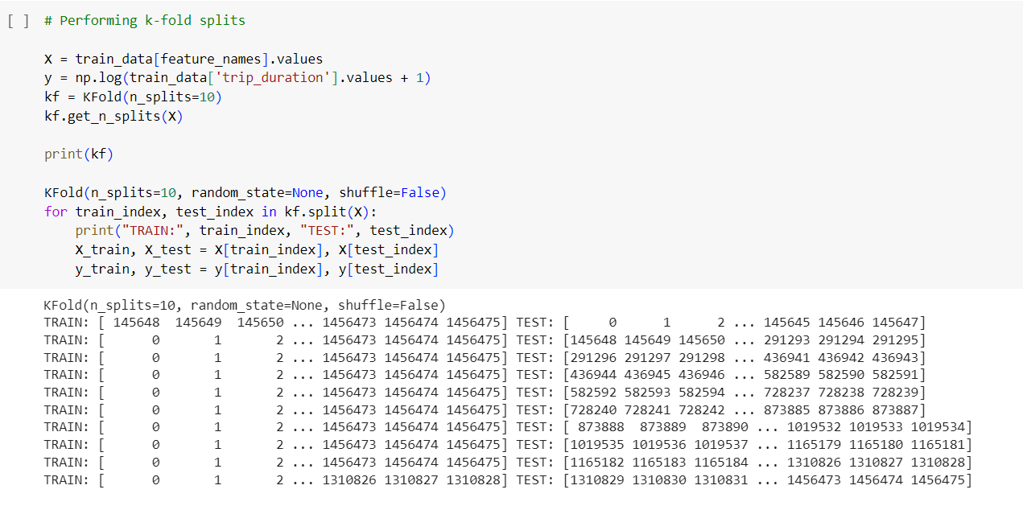

Slide 19
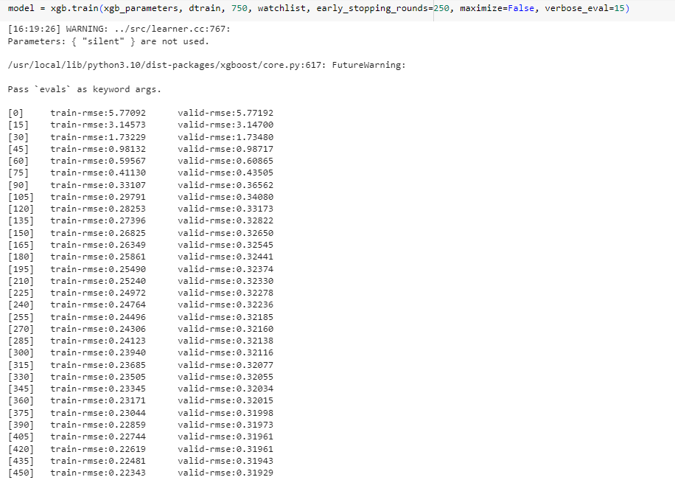

Slide 20
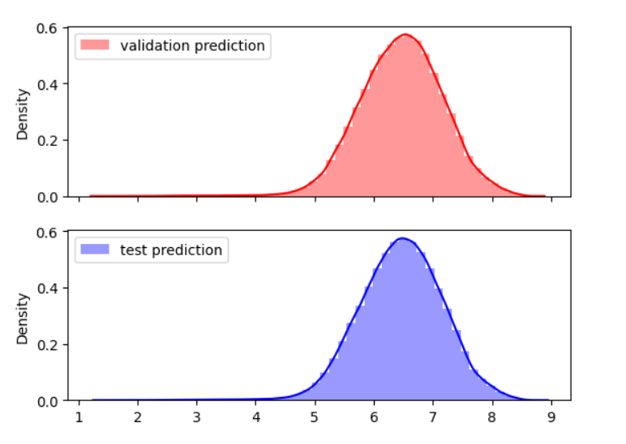
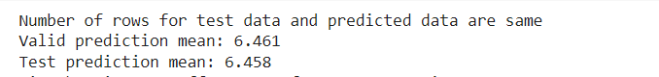
Test Model

Slide 21
Acknowledgements
I want to thank the Taxi and Limousine Commission (TLC) of New York City for granting me access to the dataset of New York taxi journeys. This dataset has been crucial to my research, allowing me to learn important things about the taxi business. I am grateful for the TLC's efforts in compiling and maintaining this extensive information, which has greatly influenced my research's conclusions.

Slide 22
References
Data Visualization and trining on - Google colab
Data set from – capabl

